Slide 1
WHICH COLLEGE SHOULD I ATTEND?
UNIVERSITY OF CALIFORNIA
VS. CALIFORNIA STATE UNIVERSITY
Tiffany Ward-Loveland – JAMS GBLA Coordinator
JAMS GBLA College Squad – Ana Galicia, Jacqueline Garcia, Maria Gomez, Dalia Molina, Lizbeth Monje, Dulce Reyes, Monica Rubio, & Jasmin Sanchez

Slide 2
UNIVERSITY OF CALIFORNIA
Statistics:
10 Campuses
Research based
Approximately $27,000 per year for total fees

Slide 3
UNIVERSITY OF CALIFORNIA
Basic Admission Requirements:
A-G Coursework
3.0 GPA (Grade Point Average)
Must take the SAT or ACT
SAT subject update: Beginning with the class of 2012 the SAT subject exams are no longer required (but they are recommended)
Comprehensive, Holistic Review
Important factors: Extracurricular activities, leadership roles, community service, etc.
Transfer Agreement Guarantee for CA Community College Students

Slide 4
UC CAMPUSES
Berkeley - Riverside
Davis - San Diego
Irvine - San Francisco
Los Angeles - Santa Barbara
Merced - Santa Cruz

Slide 5
UNIVERSITY OF CALIFORNIA

Slide 6
CALIFORNIA STATE UNIVERSITY
Statistics:
23 Campuses
Traditional University Setting
Approximately $15,000 per year for total fees

Slide 7
CALIFORNIA STATE UNIVERSITY
Basic Admission Requirements:
A-G Coursework
Must meet minimum eligibility requirement (a number derived from an equation that considers both GPA and SAT/ACT scores)
Must take the SAT or ACT
SAT subject update: Beginning with the class of 2012 the SAT subject exams are no longer required (but they are recommended)
Transfer Agreement Guarantee for CA Community College Students

Slide 8
CSU CAMPUSES
Humboldt - Bakersfield
Chico - Northridge
Sonoma - Channel Islands
Sacramento - Los Angeles
Maritime - Dominguez Hills
San Francisco - Fullerton
East Bay - Long Beach
San Jose - Pomona
Monterey Bay - San Bernardino
Stanislaus - San Marcos
Fresno - San Diego
San Luis Obispo

Slide 9
CALIFORNIA STATE UNIVERSITY

Slide 10
A-G Requirements
A
B
C
History/
Social Studies
English
Mathematics
D
E
F
G
Laboratory
Science
Language other
than English
Visual and
Performing
Arts
College
Preparatory
Elective

Slide 11
A-G REQUIREMENTS
***Please Note | Ask your high school which courses are A-G approved
2 YEARS | A: History/Social Science
4 YEARS | B: ENGLISH
3 YEARS (4 YEARS REC.) | C: MATHEMATICS
2 YEARS (3 YEARS REC.) | D: Laboratory Science
2 YEARS (3 YEARS REC.) | E: Language other than English
1 YEAR | F: Visual and Performing Arts
1 YEAR | G: College Preparatory Elective

Slide 12
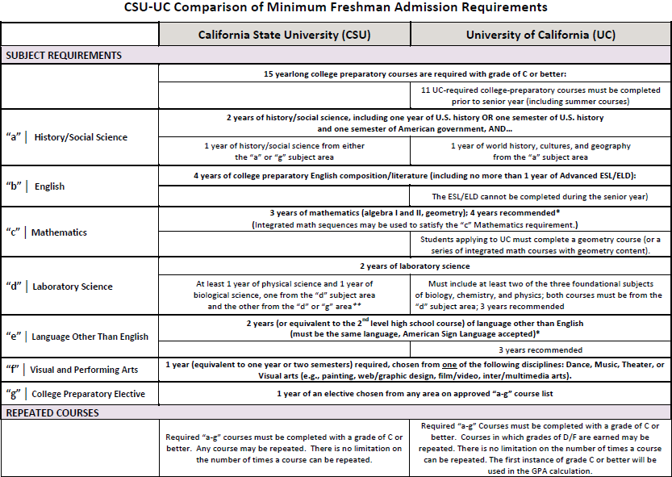

Slide 13
UC vs. CSU REQUIREMENTS
- University of California: - California State University
A-G Coursework - A-G Coursework
3.0 GPA or higher - 2.0 GPA or higher
SAT/ACT Scores - CSU Eligibility Index
SAT II recommended - SAT/ACT Scores
for certain majors - SAT II recommended
Personal Statements for certain majors
Optional Letters of - Optional EOP
Recommendation Autobiographical
(Selected UC Berkeley Responses
Applicants)

Slide 14
UCs vs. CSUs
- University of California: - California State University
Research Institutions - Traditional Education Focus
Theoretical & analytical - Practical Based Course
course material material
Annual Tuition: - Annual Tuition:
$13,000 to $15,000 $5,000 to $7,000
Degrees Offered: - Degrees Offered:
B.A./B.S B.A./B.S
M.A./M.S. M.A/M.S
Doctoral Doctoral
Professional Teaching Credentials

Slide 15
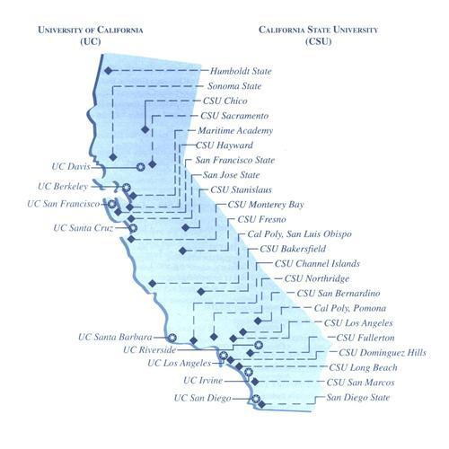
University
of
California
California
State
University

Slide 16
UC & CSU APPLICATION DATES
- University of California: - California State University
Application opens - Application opens
August 1st October 1st
Submissions: - Submissions:
November 1st – 30th October 1- November 30th
University of California:
www.admissions.universityofcalifornia.edu
California State University:
www.csumentor.edu

Slide 17
FIVE TIPS FOR HIGH SCHOOL SUCCESS
1. Make sure you take a healthy number of A-G courses EVERY year in ADDITION to your high school graduation requirements and electives.
*Remember, to pass you need a “C” or better
Show progress and diversity in your coursework. If you excel in a subject take its Honors/AP level course.
Talk to your Counselor EVERY semester!
The big question to ask is “Am I on track to apply for __________ college(s)?

Slide 18
FIVE TIPS FOR HIGH SCHOOL SUCCESS
4. Work on your application builders:
a) Extracurricular Activities: clubs, sports, student government, etc.
b) Leadership Roles
c) Community Service
Balance your school work and social life with college preparation. For example:
a) SAT/ACT preparation and examination
b) College research
c) Scholarship research and applications
d) Financial Aid research

Slide 19
RESOURCES
www.universityofcalifornia.edu
www.csumentor.edu
www.ucop.edu/agguide
fafsa.ed.gov
Talk to your academic and/or college counselor

Slide 20
QUESTIONS?
What’s Your Message?

