Slide 1

ARE YOU ELIGIBLE TO ATTEND COLLEGE?
LET’S START WITH ‘A-G REQUIREMENTS’
Tiffany Ward-Loveland – JAMS GBLA Coordinator
JAMS GBLA College Squad – Ana Galicia, Jacqueline Garcia, Maria Gomez, Dalia Molina, Lizbeth Monje, Dulce Reyes, Monica Rubio, & Jasmin Sanchez

Slide 2
What are A-G requirements?
A sequence of high school courses
Must be completed with a grade of C or better
Necessary for minimum eligibility for admission to the University of California (UC) and California State University (CSU) school systems.

Slide 3
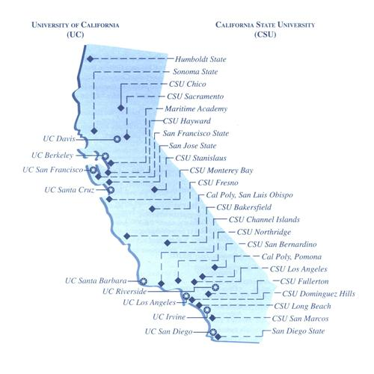
University
of
California
California
State
University

Slide 4
A-G Requirements
A
B
C
History/
Social Studies
English
Mathematics
D
E
F
G
Laboratory
Science
Language other
than English
Visual and
Performing
Arts
College
Preparatory
Elective

Slide 5

History/Social Studies
A
History/
Social Studies
2 Years Required
1 Year of World History or Geography
1 Year of U.S. History OR ½ Year of U.S. History and ½ Year of American Government

Slide 6

English
B
English
4 Years Required
Must be College Preparatory English
Honors and Advanced Placement recommended

Slide 7

Mathematics
C
Mathematics
3 Years Required
4 Years Recommended
3 years – Algebra I, Geometry, Algebra II
4th Year – Advanced courses, such as Precalculus, Calculus, Statistics

Slide 8

Laboratory Science
D
Laboratory
Science
2 Years Required
3-4 Years Recommended
1 year of life science, such as Biology
1 year of physical science, such as chemistry or physics

Slide 9

LOTE: Language other than English
E
Language other
than English
2 Years Required
3-4 Years Recommended
Needs to be 2 years of the SAME language
Examples: Spanish, French, Japanese, American Sign Language, etc.

Slide 10

Visual & Performing Arts
E
F
Visual and
Performing
Arts
Language other
than English
1 Year Required
Must be 1 year from the same discipline
Disciplines include: Dance, Music, Theater, Art

Slide 11



College Preparatory Elective
G
E
College
Preparatory
Elective
Language other
than English
1 Year Required
An extra year of any A-F requirement courses
          OR
1 year of a specifically listed course in the G-category
  Such as: Economics & Psychology

Slide 12
What does it mean?
VALIDATION

Slide 13
Validation
“UC recognizes the completion of a higher-level course with a letter grade of C or better… as demonstrating proficiency of lower-level coursework in the same subject area. This is referred to as Validation.”
This applies to:
  UC/CSU: Math & Language other than English
  CSU only: Chemistry

Slide 14
Validation
Higher-level courses completed with a C or better can validate lower-level courses in instances where students:
  Received a D or F grade in the lower-level course
  Never completed the lower-level course

Slide 15
Validation
Math
Second semester courses validate first semester.
Algebra II only validates Algebra I, not Geometry
Advanced courses beyond Algebra II validate everything before them, including validating Geometry
For the UCs, Geometry must be attempted in order to use validation

Slide 16
Validation
Language other than English
Second semester courses validate first semester.
Higher-level courses validate all levels of lower-level course

Slide 17
Validation
Chemistry
ONLY applies to Cal State universities
Second semester Chemistry validates first semester

Slide 18
Are the requirements met?
Lesley completed Algebra I and Algebra II with letter grades of C or better, has never taken Geometry but is taking Calculus now.
Meredith has passed Algebra I and Algebra II, failed the first semester of Geometry but passed the second semester of Geometry.
Andrea completed one semester of Chamber Orchestra in 10th grade and one semester of Concert Band in 11th grade.
Jordan completed 3 years of English courses and receives a D in the 1st semester of her 12th grade English class but receives a B in the second semester.
NO
YES
YES
NO

Slide 19
RESOURCES
www.universityofcalifornia.edu
www.csumentor.edu
www.ucop.edu/agguide
Talk to your academic and/or college counselor

Slide 20
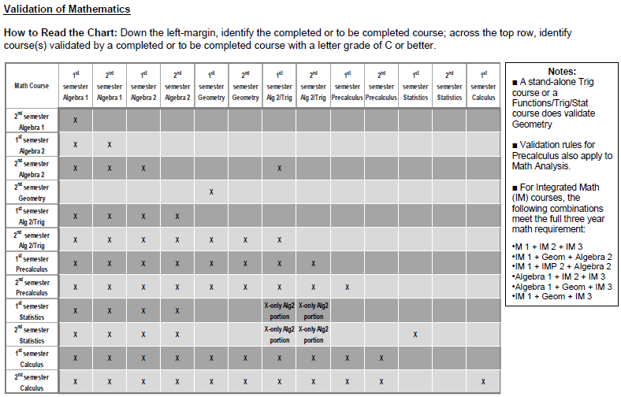

Slide 21
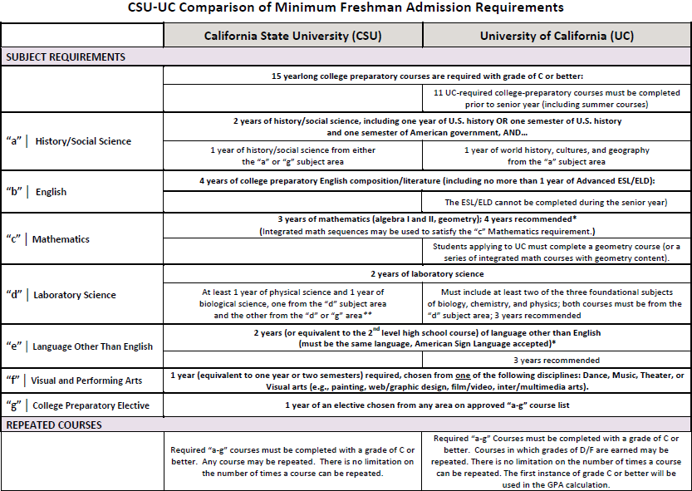

Slide 22





QUESTIONS?
What’s Your Message?

